Slide 1
Digital Portfolio
STUDENT NAME: ASIN a
REGISTER NO AND NMID: asunm1451unm1451212403592
DEPARTMENT: BCA(bachelor of computer application)
COLLEGE: COLLEGE/ UNIVERSITY: MAHALASHMI WOMENS COLLEGE of arts and science

Slide 2
STUDENT Digital Portfolio

Slide 3
AGENDA
Overview
Problem statement
Project Users
Tools and Technologies
Portfolio Design and Layout
Features and Functionality
Results and Screenshots
Conclusion

Slide 4
Overview
A student digital portfolio is an electronic collection showcasing a student's educational journey, skills, and achievements. It includes academic work, multimedia, reflections, extracurricular accomplishments, and certificates, often presented to demonstrate learning progress, growth, and competencies digitally.

Slide 5
Problem statement
Traditional paper portfolios are static, limited in media types, and harder to share. A digital portfolio solves these issues by providing an interactive, accessible platform where students can showcase diverse work such as videos, presentations, and projects with reflective narratives, enhancing engagement and learning documentation.

Slide 6
Project Users
Students building academic and skill portfolios
Teachers assessing student progress
Parents and peers viewing and providing feedback
Future employers or admissions officers evaluating capabilities

Slide 7
Tools and Technologies
CodePen: An online code editor used for writing, testing, and showcasing the portfolio's front-end code in real-time.
HTML: Provides the structural foundation of the portfolio webpage, organizing content such as text, images, and links.
CSS : A CSS preprocessor used to write modular, maintainable, and efficient styling code, making the portfolio visually appealing.
JavaScript: Adds interactivity and dynamic features such as navigation menus, animations, and user engagement components.
Additional Tools: Basic graphic design tools for creating assets and optimizing images, and browser developer tools for debugging and testing the interface.

Slide 8
Portfolio Design and Layout
Effective digital portfolio design should be:
Simple, well-structured, and visually appealing
Audience-focused (e.g., formal for employers, creative for art schools)
Balanced between multimedia and text
Featuring intuitive navigation with sections like About, Work Samples, Resume, Contact
Using professional typography and color schemes matching purpose and audience

Slide 9
Features and Functionality
Showcase best academic and extracurricular work
Include multimedia: videos, presentations, images, audio
Reflective statements explaining the significance of projects
Downloadable resume or CV
Feedback and collaboration functionalities (comments and peer reviews)

Slide 10
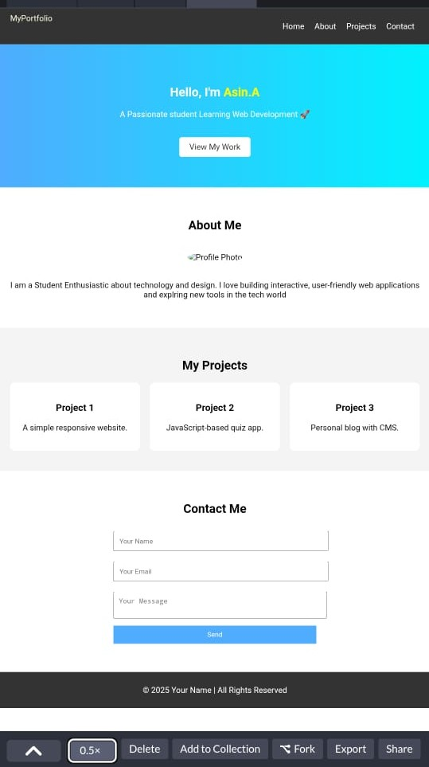
Results and Screenshots
Screenshots typically show a clean homepage with navigation, project galleries, multimedia content, and sections for biography and contact.

Slide 11
Conclusion
Student digital portfolios are powerful tools that provide a versatile, engaging, and comprehensive platform to document a learner’s progress, skills, and achievements. They support deeper learning, self-reflection, and better showcase students' potential for future academic and career opportunities.

Slide 12
THANK YOU

